Slide 1
I-star Model Regression
邢子謙 07/24

Slide 2
I-star Model Types
3-steps I-star Model
Simplified I-star Model

Slide 3
Setting
Stock : 2914.T
Time :
1. Train : 2021.08.04 ~ 2022.04.28, Test : 2022.05.02 ~ 2022.06.30
2. Train : 2022.03.01 ~ 2022.05.31, Test : 2022.06.01 ~ 2022.06.30
Data :
1. Original, 2. Without outlier(V > 2*ADV, delta(P) > 3*sigma)
Heterogeneity :
1. Original, 2. Hetero. adjusted
Model :
1. Linear I-star, 2. Exponential I-star
Sign(Imbalance) :
1. Original, 2. Absolute value

Slide 4
Case
Case 1 : original data / no hetero. adj. / linear I-star / original sign(Q)
Case 2 : without outlier / no hetero. adj. / linear I-star / original sign(Q)
Case 3 : original data / hetero. adj. / linear I-star / original sign(Q)
Case 4 : without outlier / hetero. adj. / linear I-star / original sign(Q)
Case 5 : original data / no hetero. adj. / expo. I-star / original sign(Q)
Case 6 : without outlier / no hetero. adj. / expo. I-star / original sign(Q)
Case 7 : original data / hetero. adj. / linear I-star / absolute sign(Q)
Case 8 : without outlier / hetero. adj. / linear I-star / absolute sign(Q)

Slide 5
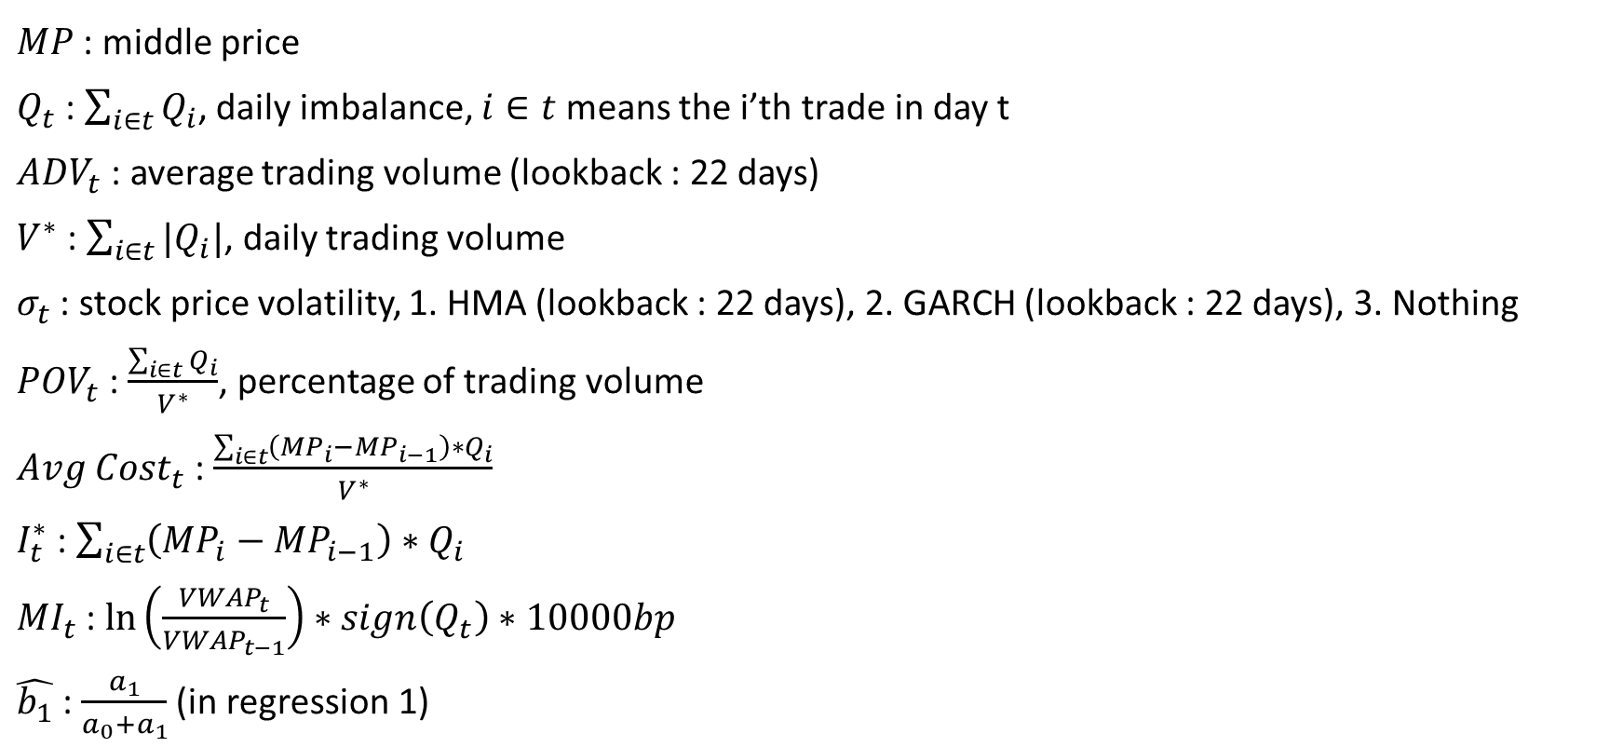
Variable(original)
$MP$ : middle price
$Q_{t}$ : $\sum_{i∈t}{Q_{i}}$, daily imbalance, $i∈t$ means the i’th trade in day t
${ADV}_{t}$ : average trading volume (lookback : 22 days)
$V^{∗}$ : $\sum_{i∈t}{|Q_{i}|}$, daily trading volume
$σ_{t}$ : stock price volatility, 1. HMA (lookback : 22 days), 2. GARCH (lookback : 22 days), 3. Nothing
${POV}_{t}$ : $\frac{\sum_{i∈t}{Q_{i}}}{V^{∗}}$, percentage of trading volume
${Avg Cost}_{t}$ : $\frac{\sum_{i∈t}{\left({MP}_{i}−{MP}_{i−1}\right)∗Q_{i}}}{V^{∗}}$
$I_{t}^{∗}$ : $\sum_{i∈t}{\left({MP}_{i}−{MP}_{i−1}\right)∗Q_{i}}$
${MI}_{t}$ : $\ln\left(\frac{{VWAP}_{t}}{{VWAP}_{t−1}}\right)∗sign\left(Q_{t}\right)∗10000bp$
$\hat{b_{1}}$ : $\frac{a_{1}}{a_{0}+a_{1}}$ (in regression 1)

Slide 6
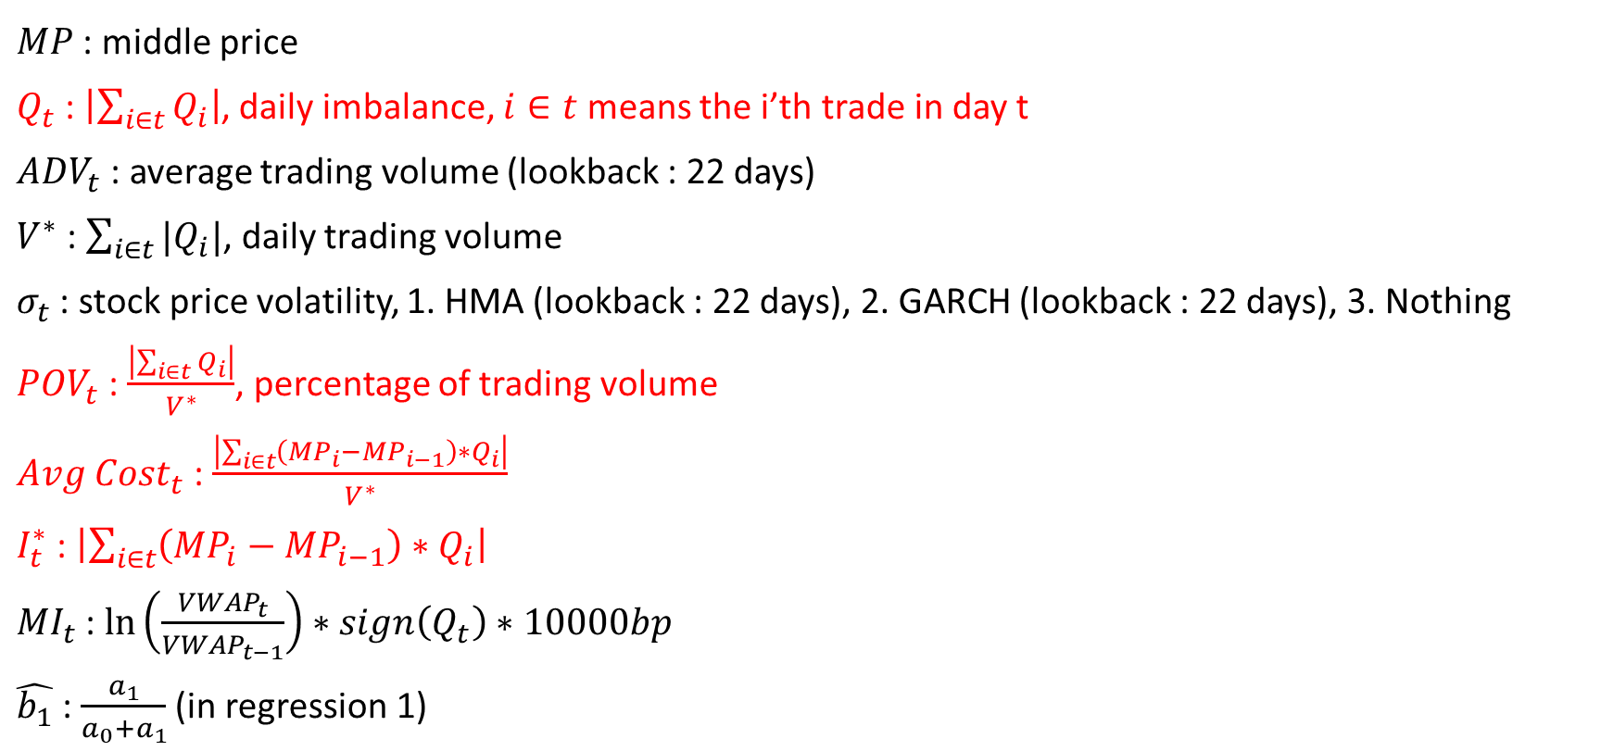
Variable(absolute sign(Q))
$MP$ : middle price
$Q_{t}$ : $\left|\sum_{i∈t}{Q_{i}}\right|$, daily imbalance, $i∈t$ means the i’th trade in day t
${ADV}_{t}$ : average trading volume (lookback : 22 days)
$V^{∗}$ : $\sum_{i∈t}{|Q_{i}|}$, daily trading volume
$σ_{t}$ : stock price volatility, 1. HMA (lookback : 22 days), 2. GARCH (lookback : 22 days), 3. Nothing
${POV}_{t}$ : $\frac{\left|\sum_{i∈t}{Q_{i}}\right|}{V^{∗}}$, percentage of trading volume
${Avg Cost}_{t}$ : $\frac{\left|\sum_{i∈t}{\left({MP}_{i}−{MP}_{i−1}\right)∗Q_{i}}\right|}{V^{∗}}$
$I_{t}^{∗}$ : $\left|\sum_{i∈t}{\left({MP}_{i}−{MP}_{i−1}\right)∗Q_{i}}\right|$
${MI}_{t}$ : $\ln\left(\frac{{VWAP}_{t}}{{VWAP}_{t−1}}\right)∗sign\left(Q_{t}\right)∗10000bp$
$\hat{b_{1}}$ : $\frac{a_{1}}{a_{0}+a_{1}}$ (in regression 1)

Slide 7

Regression 1
Original regression :
$${Avg Cost}_{t}=a_{0}+a_{1}∗{POV}_{t}$$
Heterogeneity adjusted :
$$\frac{{Avg Cost}_{t}}{\sqrt{|{POV}_{t}|}}=\frac{a_{0}}{\sqrt{|{POV}_{t}|}}+a_{1}∗\frac{{POV}_{t}}{\sqrt{|{POV}_{t}|}}$$

Slide 8
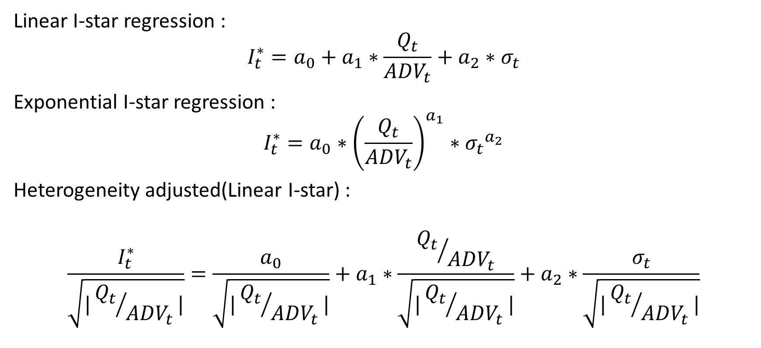
Regression 2
Linear I-star regression :
$$I_{t}^{∗}=a_{0}+a_{1}∗\frac{Q_{t}}{{ADV}_{t}}+a_{2}∗σ_{t}$$
Exponential I-star regression :
$$I_{t}^{∗}=a_{0}∗{\left(\frac{Q_{t}}{{ADV}_{t}}\right)}^{a_{1}}∗{σ_{t}}^{a_{2}}$$
Heterogeneity adjusted(Linear I-star) :
$$\frac{I_{t}^{∗}}{\sqrt{|{Q_{t}}/{{ADV}_{t}}|}}=\frac{a_{0}}{\sqrt{|{Q_{t}}/{{ADV}_{t}}|}}+a_{1}∗\frac{{Q_{t}}/{{ADV}_{t}}}{\sqrt{|{Q_{t}}/{{ADV}_{t}}|}}+a_{2}∗\frac{σ_{t}}{\sqrt{|{Q_{t}}/{{ADV}_{t}}|}}$$

Slide 9
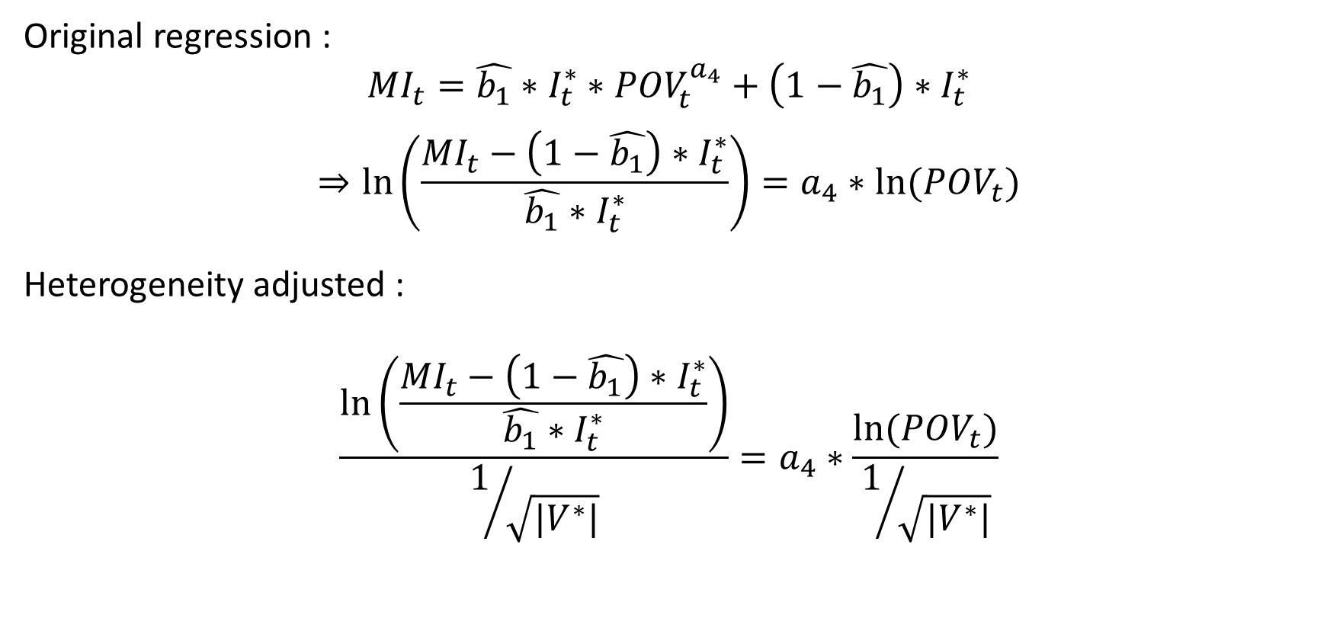
Regression 3
Original regression :
$${MI}_{t}=\hat{b_{1}}∗I_{t}^{∗}∗{POV}_{t}^{a_{4}}+\left(1−\hat{b_{1}}\right)∗I_{t}^{∗}$$
$$⇒\ln\left(\frac{{MI}_{t}−\left(1−\hat{b_{1}}\right)∗I_{t}^{∗}}{\hat{b_{1}}∗I_{t}^{∗}}\right)=a_{4}∗ln⁡({POV}_{t})$$
Heterogeneity adjusted :
$$\frac{\ln\left(\frac{{MI}_{t}−\left(1−\hat{b_{1}}\right)∗I_{t}^{∗}}{\hat{b_{1}}∗I_{t}^{∗}}\right)}{1/{\sqrt{|V^{∗}|}}}=a_{4}∗\frac{ln⁡({POV}_{t})}{1/{\sqrt{|V^{∗}|}}}$$

Slide 10
Result 1
Case 1 : original data / no hetero. adj. / linear I-star / original sign(Q)
 | Training set 21.08.04 ~ 22.04.28 | Testing set 21.05.02 ~ 22.06.30 | Training set 22.03.01 ~ 22.05.31 | Testing set 21.06.01 ~ 22.06.30
Sigma choose | GARCH (r2 = 0.431) | GARCH | HMA (r2 = -0.608) | HMA
MAE | 1.6461 | 1.3714 | 1.7125 | 1.8220
MAPE | 0.3968 | 0.3315 | 0.3759 | 0.3989
MSE | 3.8187 | 2.5789 | 4.1610 | 4.1149
RMSE | 1.9542 | 1.6059 | 2.0399 | 2.0285
NRMSE | 0.8262 | 1.0353 | 0.8291 | 1.1601
R-squared | 0.778 | -1653.5098 | 0.800 | -164065.0918

Slide 11
Result 2
Case 2 : without outlier / no hetero. adj. / linear I-star / original sign(Q)
 | Training set 21.08.04 ~ 22.04.28 | Testing set 21.05.02 ~ 22.06.30 | Training set 22.03.01 ~ 22.05.31 | Testing set 21.06.01 ~ 22.06.30
Sigma choose | HMA (r2 = 0.326) | HMA | HMA (r2 = -0.473) | HMA
MAE | 1.9475 | 1.5929 | 2.0876 | 2.1771
MAPE | 0.4082 | 0.3279 | 0.3967 | 0.4078
MSE | 5.3615 | 3.4482 | 5.9701 | 5.7933
RMSE | 2.3155 | 1.8569 | 2.4434 | 2.4069
NRMSE | 0.8210 | 1.0391 | 0.8935 | 1.1726
R-squared | 0.772 | -388.8815 | 0.790 | -14567.4476

Slide 12
Result 3
Case 3 : original data / hetero. adj. / linear I-star / original sign(Q)
 | Training set 21.08.04 ~ 22.04.28 | Testing set 21.05.02 ~ 22.06.30 | Training set 22.03.01 ~ 22.05.31 | Testing set 21.06.01 ~ 22.06.30
Sigma choose | GARCH (r2 = 0.312) | GARCH | Nothing (r2 = 0.213) | Nothing
MAE | 3511.2785 | 3401.4168 | 3754.1222 | 4010.6023
MAPE | 0.4044 | 0.3382 | 0.3843 | 0.4253
MSE | 17902777.1254 | 15653193.9889 | 20742565.6199 | 19000255.7706
RMSE | 4231.1673 | 3956.4118 | 4554.4007 | 4358.9283
NRMSE | 0.7312 | 1.0107 | 0.7693 | 1.2217
R-squared | 0.778 | -2.6026 | 0.790 | -5.4004

Slide 13
Result 4
Case 4 : without outlier / hetero. adj. / linear I-star / original sign(Q)
 | Training set 21.08.04 ~ 22.04.28 | Testing set 21.05.02 ~ 22.06.30 | Training set 22.03.01 ~ 22.05.31 | Testing set 21.06.01 ~ 22.06.30
Sigma choose | Nothing (r2 = 0.287) | Nothing | Nothing (r2 = 0.256) | Nothing
MAE | 3553.4449 | 3633.3778 | 3811.2042 | 4055.502
MAPE | 0.4123 | 0.3662 | 0.3916 | 0.4248
MSE | 18151870.1385 | 18022061.6840 | 21071157.5759 | 19440629.4168
RMSE | 4260.5012 | 4245.2399 | 4590.3331 | 4409.1529
NRMSE | 0.7471 | 0.9782 | 0.7959 | 1.2209
R-squared | 0.766 | -2.6069 | 0.772 | -5.3396

Slide 14
Result 5
Case 5 : original data / no hetero. adj. / expo. I-star / original sign(Q)
 | Training set 21.08.04 ~ 22.04.28 | Testing set 21.05.02 ~ 22.06.30 | Training set 22.03.01 ~ 22.05.31 | Testing set 21.06.01 ~ 22.06.30
Sigma choose | GARCH (r2 = 0.436) | GARCH | HMA (r2 = 0.350) | HMA
MAE | 1.3523 | 1.1877 | 1.4438 | 1.5809
MAPE | 0.3270 | 0.2863 | 0.3197 | 0.3458
MSE | 2.7671 | 2.1795 | 3.6135 | 3.3043
RMSE | 1.6635 | 1.4763 | 1.9009 | 1.8178
NRMSE | 0.6462 | 0.8549 | 0.6343 | 1.1029
R-squared | 0.839 | -20473.7922 | 0.826 | -22250.5395

Slide 15
Result 6
Case 6 : without outlier / no hetero. adj. / expo. I-star / original sign(Q)
 | Training set 21.08.04 ~ 22.04.28 | Testing set 21.05.02 ~ 22.06.30 | Training set 22.03.01 ~ 22.05.31 | Testing set 21.06.01 ~ 22.06.30
Sigma choose | HMA (r2 = 0.392) | HMA | HMA (r2 = 0.325) | HMA
MAE | 1.5974 | 1.3882 | 1.7798 | 1.8980
MAPE | 0.3339 | 0.2868 | 0.3458 | 0.3551
MSE | 3.9337 | 2.9766 | 5.4987 | 4.6951
RMSE | 1.9833 | 1.7253 | 2.3449 | 2.1668
NRMSE | 0.6222 | 0.8613 | 0.6251 | 1.1144
R-squared | 0.832 | -6962.8976 | 0.805 | -2987.7621

Slide 16
Result 7
Case 7 : original data / hetero. adj. / linear I-star / absolute sign(Q)
 | Training set 21.08.04 ~ 22.04.28 | Testing set 21.05.02 ~ 22.06.30 | Training set 22.03.01 ~ 22.05.31 | Testing set 21.06.01 ~ 22.06.30
Sigma choose | GARCH (r2 = 0.416) | GARCH | HMA (r2 = -2.507) | HMA
MAE | 2365.4940 | 2309.4001 | 3740.9588 | 3990.8583
MAPE | 0.4044 | 0.3421 | 0.3847 | 0.4251
MSE | 8141785.5548 | 7232817.3405 | 20500660.4096 | 18828642.1601
RMSE | 2853.3814 | 2689.3898 | 4527.7655 | 4339.1983
NRMSE | 0.7277 | 1.0138 | 0.7740 | 1.2206
R-squared | 0.778 | -2.6734 | 0.779 | -5.3809

Slide 17
Result 8
Case 8 : without outlier / hetero. adj. / linear I-star / absolute sign(Q)
 | Training set 21.08.04 ~ 22.04.28 | Testing set 21.05.02 ~ 22.06.30 | Training set 22.03.01 ~ 22.05.31 | Testing set 21.06.01 ~ 22.06.30
Sigma choose | HMA (r2 = 0.057) | HMA | HMA (r2 = -0.302) | HMA
MAE | 2263.2835 | 2257.5655 | 3774.6896 | 4008.0836
MAPE | 0.4119 | 0.3484 | 0.3959 | 0.4279
MSE | 7311655.6048 | 6813943.9295 | 20351305.1760 | 18928816.7888
RMSE | 2704.0073 | 2610.3532 | 4511.2421 | 4350.7260
NRMSE | 0.7625 | 1.0192 | 0.8093 | 1.2249
R-squared | 0.767 | -2.3077 | 0.769 | -5.3714

Slide 18
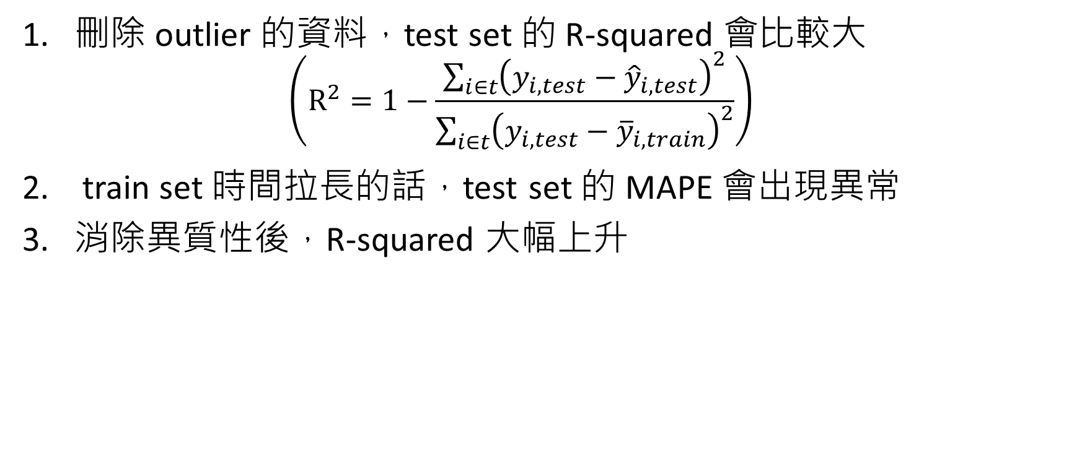
Conclusion from data
刪除 outlier 的資料，test set 的 R-squared 會比較大 $\left(R^{2}=1−\frac{\sum_{i∈t}{{\left(y_{i,test}−{\hat{y}}_{i,test}\right)}^{2}}}{\sum_{i∈t}{{\left(y_{i,test}−{\overline{y}}_{i,train}\right)}^{2}}}\right)$
train set 時間拉長的話，test set 的 MAPE 會出現異常
消除異質性後，R-squared 大幅上升

Slide 19
Problem
根據公式來看，I-star 本身是希望透過過去的交易資料來預測股價，若單純使用固定的 data 應該是不會有預測效果，未來可嘗試使用“Rolling”的方式處理。
I-star 變數定義較為困難，現有的定義與 MI 的數量及相差過大，因此在處理第三條回歸式時會產生log內皆為負號的問題。
資料處理上不允許 MI 和 I-star 使用共同的基準，MI 需要有逐筆資料的 VWAP 才可以使用 tick data，而 I-star 則會有高、低估的問題存在。

Slide 20
I-star 高、低估問題
假設現在有三筆數量為 V 的交易，造成 10V 的瞬時影響，並個別會遞延 1V 的永久影響。
若使用 tick data，我們可以記錄下來 : 三筆 V 造成 10V 的結果 但因為 MI 無法使用 tick data，因此無法使用
若使用 interval data，則為 : 一筆 3V 造成 12V 的結果 但因為 data 放入回歸前已經過前處理，因此會產生誤差

